Slide 1
Supply Chain Performance: Achieving Strategic Fit and Scope

Slide 2
Learning Objectives
Explain why achieving strategic fit is critical to a company’s overall success
Describe how a company achieves strategic fit between its supply chain strategy and its competitive strategy
Discuss the importance of expanding the scope of strategic fit across the supply chain
Describe the major challenges that must be overcome to manage a supply chain successfully

Slide 3
Competitive and Supply Chain Strategies
Competitive strategy: It defines the set of customer needs that it seeks to satisfy through its products and services
Example:
Wal-Mart aims to provide high availability of a variety of products of reasonable quality at low prices
In contrast, McMaster-Carr sells maintenance, repair, and operations (MRO) products. Its competitive strategy is to provide the customer with convenience, availability, and responsiveness

Slide 4
Dell has stressed customization and variety at a reasonable cost, but waiting time is approximately one week.
In contrast, a customer can walk into a computer retailer and get the computer same day, but variety is limited
A firm's competitive strategy will be defined based on its customers‘ priorities

Slide 5
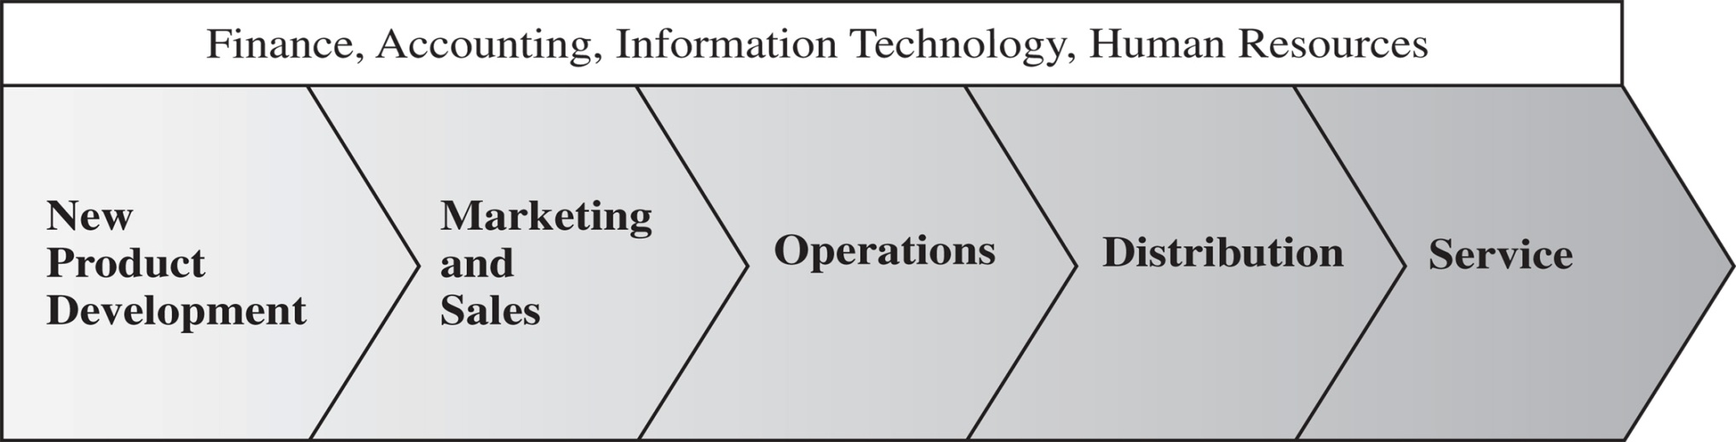
The value chain
To see the relationship between competitive and supply chain strategies, consider the following value chain
Figure 2-1

Slide 6
A product development strategy
Creates specifications for the product
Specifies the portfolio of new products that a company will try to develop
Dictates whether the development effort will be made internally or outsourced

Slide 7
Marketing and sales
Generates demand by publicizing the customer priorities
Brings customer input back to new product development
Specifies how the market will be segmented and how the product will be positioned, priced, and promoted

Slide 8
Operations
Transforms inputs to outputs to create the product
Takes the product to the customer or brings the customer to the product
Responds to customer requests during or after the sale
Distribution
Service

Slide 9
Supply chain strategy
Determines the nature of procurement of raw materials, transportation of materials, manufacture of the product or operation to provide the service, and distribution of the product

Slide 10
Supply chain strategy
It defines role played by each supply chain entity
Example:
Cisco's supply chain strategy calls for most component manufacturing and assembly to be outsourced
So here, strategy identifies not just what Cisco should do well but also the role of each third party to which supply chain tasks are outsourced

Slide 11
Supply chain strategy
Includes a specification of the broad structure of the supply chain
Also called as "supplier strategy," "operations strategy” and "logistics strategy.“
Example:
Dell's decision to sell direct, Gateway's decision to sell PCs through resellers, and Cisco's decision to use contract manufacturers define the broad structure of their supply chains

Slide 12
Supply chain strategy
Supply chain strategy also includes design decisions regarding inventory, transportation, operating facilities, and information flows
Example:
Amazon has decided to build warehouses to stock some products and to continue using distributors as a source of other products
Toyota's decision to have production facilities in each of its major markets is part of its supply chain strategy

Slide 13
The various functional strategies cannot be formulated in isolation. They must fit and support each other if a company is to succeed
Example: Seven- Eleven Japan
Marketing at Seven-Eleven has emphasized convenience in the form of easy access
New product development at Seven-Eleven is constantly adding products and services
Operations and distribution at Seven-Eleven have focused on having a high density of stores, being very responsive, and providing an excellent information

Slide 14
Achieving Strategic Fit
Supply chain strategy and competitive strategy must fit together
Strategic fit -Both the competitive and supply chain strategies have aligned goals
Achieving strategic fit is a key consideration during the supply chain strategy or design phase

Slide 15
Achieving Strategic Fit
Keys to company’s success
1. The competitive strategy and all functional strategies must fit together to form a coordinated overall strategy.
2. The different functions in a company must
appropriately structure their processes and resources to
be able to execute these strategies successfully.
3. The design of the overall supply chain and the role of each stage must be aligned to support the supply chain strategy

Slide 16
Achieving Strategic Fit
A company may fail because of a lack of strategic fit or because its processes and resources do not provide the capabilities to execute the desired strategy.

Slide 17
Achieving Strategic Fit
Example:
A Company’s marketing department publicizes to provide a large variety of products very quickly and distribution is targeting the lowest cost means of transportation
Distribution will delay orders to get better transportation economies so the transportation will be slow which conflicts with the goal of providing variety quickly

Slide 18
Achieving Strategic Fit
Example: Dell
Dell's competitive strategy is to provide a large variety of customizable products at a reasonable price
In terms of supply chain strategy,
At one extreme, a company can have an efficient supply chain with a focus on the ability to produce low-cost PCs by limiting variety and exploiting economies of scale. At the other extreme, a company can have a highly flexible and responsive supply chain that is very good at producing a large variety of products where cost is more

Slide 19
Achieving Strategic Fit
Example- Dell (contd...)
A supply chain strategy that emphasizes flexibility and responsiveness has a better strategic fit with Dell's competitive strategy.
Dell products use common components and are designed to be assembled quickly. This feature allows Dell to assemble customized PCs quickly in response to a customer order
Dell’s capability supports Dell's strategic goal of offering customization to its customers.

Slide 20
How is Strategic Fit Achieved?
Three basic steps to achieving strategic fit
1.Understanding the Customer and Supply Chain Uncertainty-Identifying the uncertainties that the supply chain faces while satisfying customer needs
2.Understanding the Supply Chain Capabilities: A company must understand what its supply chain is designed to do well.
3.Achieving Strategic Fit-Mismatch occurs between customer needs and what the supply chain is providing, then strategy may be changed or supply chain must be altered.

Slide 21
Step 1 : Understanding the Customer and Supply Chain Uncertainty
Customer needs are different
Example:
When customers go to Seven-Eleven to purchase detergent, they go there for the convenience of a nearby store and are not necessarily looking for the lowest price.
Whereas, Sam's Club customer may be willing to tolerate less variety and even purchase very large package sizes as long as the price is low. Customer need is low price.

Slide 22
Step 1 : Understanding the Customer and Supply Chain Uncertainty
Several attributes
1.The Quantity of the Product Needed in Each Lot
An emergency order for material needed to repair a production line is likely to be small. An order for material to construct a new production line is likely to be large.

Slide 23
Step 1 : Understanding the Customer and Supply Chain Uncertainty
2. The Response Time that Customers are Willing to Tolerate:
The tolerable response time for the emergency order is likely to be short, whereas the allowable response time for the construction order is apt to be long

Slide 24
Step 1 : Understanding the Customer and Supply Chain Uncertainty
3. The Variety of Products Needed:
A customer may place a high premium on the availability of all parts of an emergency repair order from a single supplier. This may not be the case for the construction order.

Slide 25
Step 1 : Understanding the Customer and Supply Chain Uncertainty
4. The Service Level Required:
A customer placing an emergency order expects a high level of product availability

Slide 26
Step 1 : Understanding the Customer and Supply Chain Uncertainty
5. The Price of the Product:
The customer placing the emergency order is apt to be much less sensitive to price than the customer placing the construction order.

Slide 27
Step 1 : Understanding the Customer and Supply Chain Uncertainty
6. The Desired Rate of Innovation in the Product:
Customers at a high-end department store expect a lot of innovation and new designs in the store's apparel. Customers at Wal-Mart may be less sensitive to new product innovation.

Slide 28
Step 1 : Understanding the Customer and Supply Chain Uncertainty
All these attributers are combined in one key attribute and one needs to measure that attribute only.

Slide 29
Step 1 : Understanding the Customer and Supply Chain Uncertainty
Implied Demand Uncertainty
Each customer need can be translated into the metric of implied demand uncertainty
Implied demand uncertainty is demand uncertainty due to the portion of demand that the supply chain is targeting, not the entire demand

Slide 30
Step 1 : Understanding the Customer and Supply Chain Uncertainty
Demand uncertainty reflects the uncertainty of customer demand for a product whereas, Implied demand uncertainty is the resulting uncertainty for only the portion of the demand that the supply chain plans to satisfy and the attributes the customer desires

Slide 31
Step 1 : Understanding the Customer and Supply Chain Uncertainty
Example:
A firm supplying only emergency orders for a product will face a higher implied demand uncertainty than a firm that supplies the same product with a long lead time, as the second firm has an opportunity to fulfil the orders evenly over the long lead time

Slide 32
Step 1 : Understanding the Customer and Supply Chain Uncertainty
Raising the service level increases the implied demand uncertainty even though the product's underlying demand uncertainty does not change
As a supply chain raises its level of service, it must be able to meet a higher and higher percentage of actual demand, forcing it to prepare for rare surges in demand

Slide 33
Customers needs and Implied Uncertainty
Table 2-1 illustrates how various customer needs
affect implied demand uncertainty
Customer Need | Causes Implied Demand Uncertainty to …
Range of quantity required increases | Increase because a wider range of the quantity required implies greater variance in demand
Lead time decreases | Increase because there is less time in which to react to orders
Variety of products required increases | Increase because demand per product becomes more disaggregate
Number of channels through which product may be acquired increases | Increase because the total customer demand is now disaggregated over more channels
Rate of innovation increases | Increase because new products tend to have more uncertain demand
Required service level increases | Increase because the firm now has to handle unusual surges in demand
Table 2-1

Slide 34
Implied Uncertainty and Other Attributes
Implied demand uncertainty is often correlated with
other characteristics of demand as shown in Fisher
chart
 | Low Implied Uncertainty | High Implied Uncertainty
Product margin | Low | High
Average forecast error | 10% | 40% to 100%
Average stockout rate | 1% to 2% | 10% to 40%
Average forced season-end markdown | 0% | 10% to 25%
Table 2-2

Slide 35
Implied Uncertainty and Other Attributes
Explanation
1. Products with uncertain demand are often less mature and have less direct competition. As a result, margins tend to be high.

Slide 36
Implied Uncertainty and Other Attributes
2. Forecasting is more accurate when demand has less uncertainty.

Slide 37
Implied Uncertainty and Other Attributes
3. Increased implied demand uncertainty leads to increased difficulty in matching supply with demand. For a given product, this dynamic can lead to either a stockout or an oversupply situation. Increased implied demand uncertainty thus leads to both higher oversupply and a higher stockout rate.

Slide 38
Implied Uncertainty and Other Attributes
4. Markdowns are high for products with high implied demand uncertainty because oversupply often results.

Slide 39
Implied Uncertainty and Other Attributes
Example:
Consider table salt. Salt has a very low margin, accurate demand forecasts, low stockout rates, and virtually no markdowns. These characteristics match well with Fisher's chart of characteristics for products with highly certain demand

Slide 40
Implied Uncertainty and Other Attributes
Example:
A new palmtop computer has high implied demand uncertainty. It will likely have a high margin, very inaccurate demand forecasts, high stockout rates (if it is successful), and large markdowns (if it is a failure).

Slide 41
Example:
Circuit board supplier- 2 different customers
One is build to order manufacturer as Dell that requires same-day lead times. In this case, the supplier might need to build up inventory to be prepared for whatever demand Dell has that day. Forecast error and supplier inventories would be high, Margins would likely be higher.
Other customer builds a small variety of PCs and specifies in advance the number and type of PCs to be built. This gives the supplier a longer lead time and reduces the forecasting errors and inventories. The supplier would likely get smaller margins

Slide 42
Impact of Supply Source Capability
Along with demand uncertainty, it is important to consider uncertainty resulting from the capability of the supply chain

Slide 43
Impact of Supply Source Capability
Example
When a new component is introduced in the PC industry, the quality yields of the production process tend to be low and breakdowns are frequent. As a result, companies have difficulty delivering according to a well-defined schedule, resulting in high supply uncertainty for PC manufacturers.

Slide 44
Impact of Supply Source Capability
Table 2-3 illustrates how various characteristics of
supply sources affect the supply uncertainty
Supply Source Capability | Causes Supply Uncertainty to...
Frequent breakdowns | Increase
Unpredictable and low yields | Increase
Poor quality | Increase
Limited supply capacity | Increase
Inflexible supply capacity | Increase
Evolving production process | Increase
Table 2-3

Slide 45
Supply uncertainty is also strongly affected by the life-cycle position of the product.
New products being introduced have higher supply uncertainty because designs and production processes are still evolving. In contrast, mature products have less supply uncertainty

Slide 46
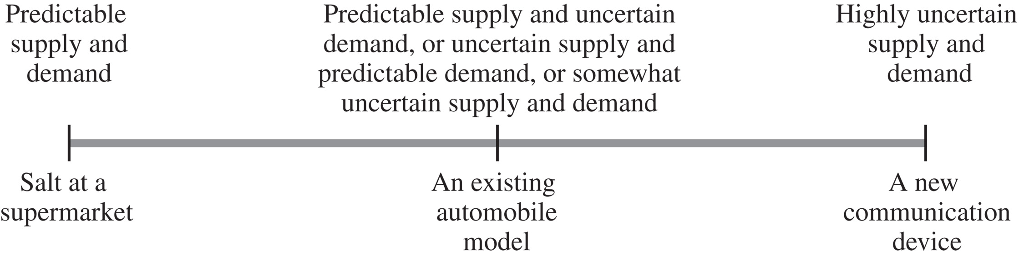
The Implied Uncertainty Spectrum
A spectrum of uncertainty by combining the demand and supply uncertainty can be created. This implied uncertainty spectrum is shown in Figure 2-2
Figure 2-2

Slide 47
Other examples
A company introducing a brand-new cell phone based on entirely new components and technology faces high implied demand uncertainty and high supply uncertainty. As a result, the implied uncertainty faced by the supply chain is very high.
A supermarket selling salt faces low implied demand uncertainty and low levels of supply uncertainty, resulting in a low implied uncertainty

Slide 48
Step 2: Understanding Supply Chain Capabilities
How does the firm best meet demand in that uncertain environment?
Creating strategic fit is all about creating a supply chain strategy that best meets the demand a company has targeted given the uncertainty it faces.

Slide 49
Step 2: Understanding Supply Chain Capabilities
Supply chain responsiveness includes a supply chain's ability to do the following:
• Respond to wide ranges of quantities demanded
• Meet short lead times
• Handle a large variety of products
• Build highly innovative products
• Meet a high service level
• Handle supply uncertainty

Slide 50
Step 2: Understanding Supply Chain Capabilities
Supply chain efficiency is the inverse of the cost of making and delivering a product to the customer. Increase in cost lower efficiency. For every strategic choice to increase responsiveness, there are additional costs that lower efficiency.

Slide 51
Step 2: Understanding Supply Chain Capabilities
The cost-responsiveness efficient frontier is the curve in Figure 2-3 showing the lowest possible cost for a given level of responsiveness. Lowest cost is defined based on existing technology; not every firm is able to operate on the efficient frontier. The efficient frontier represents the cost-responsiveness performance of the best supply chains

Slide 52
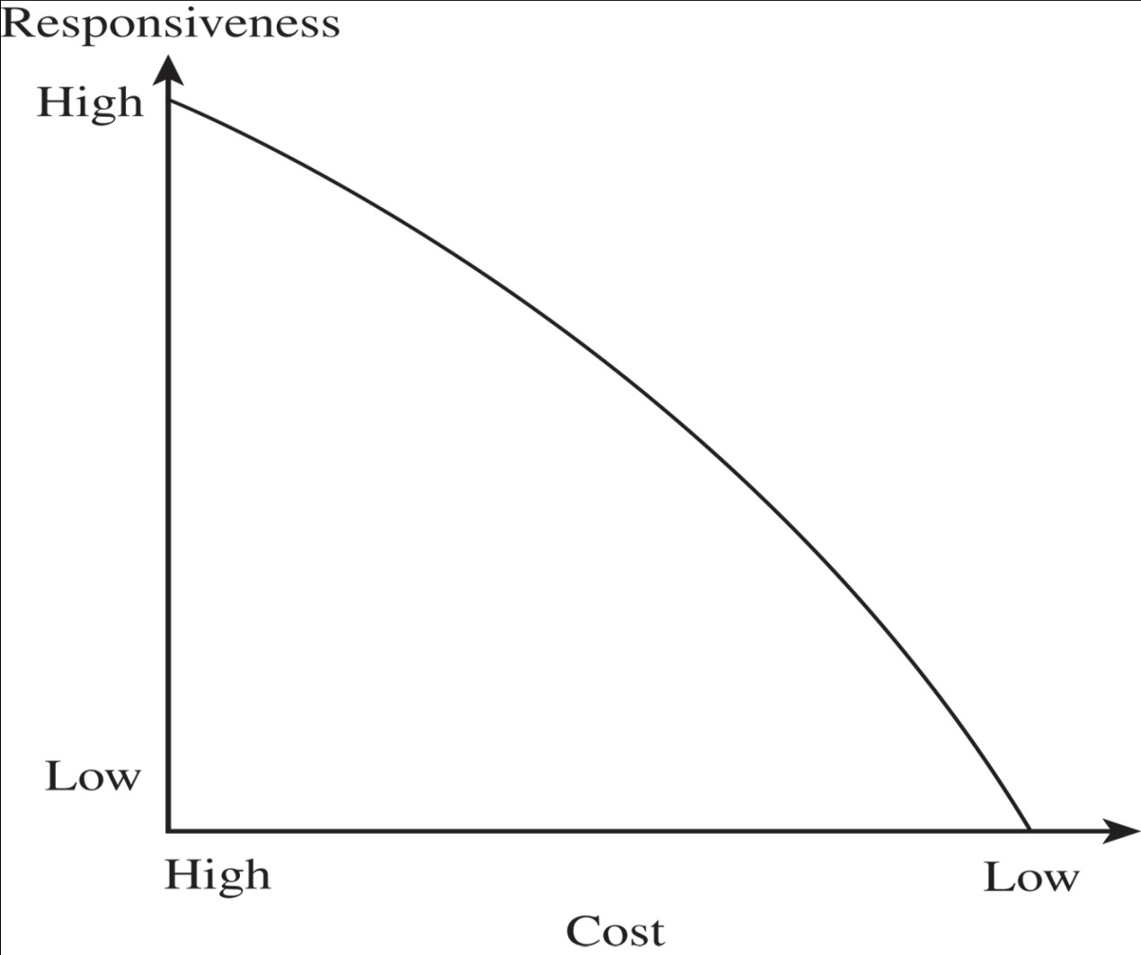
Step 2: Understanding Supply Chain Capabilities
Cost-Responsiveness Efficient Frontier
Figure 2-3

Slide 53
Cost-Responsiveness Efficient Frontier
A firm that is not on the efficient frontier can improve both its responsiveness and its cost performance by moving toward the efficient frontier.
In contrast, a firm on the efficient frontier can improve its responsiveness only by increasing cost and becoming less efficient. Such a firm must then make a trade-off between efficiency and responsiveness.

Slide 54
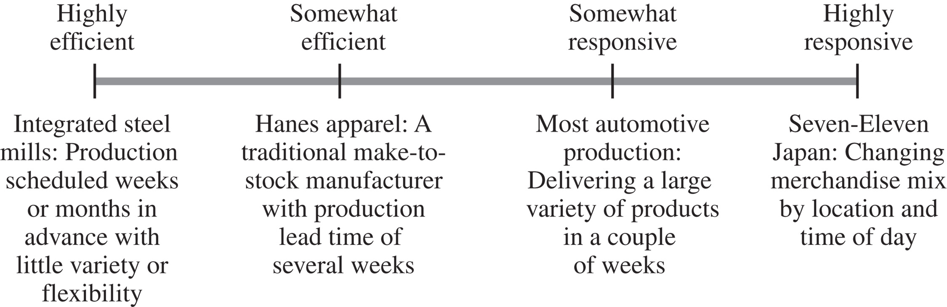
Responsiveness Spectrum
Figure 2-4 shows the responsiveness spectrum and where some supply chains fall on this spectrum
Figure 2-4

Slide 55
Responsiveness Spectrum
Seven-Eleven Japan replenishes its stores with breakfast items in the morning, lunch items in the afternoon, and dinner items at night. As a result, the available product variety changes by time of day. This practice makes the Seven-Eleven supply chain very responsive.

Slide 56
Responsiveness Spectrum
The Dell supply chain allows a customer to customize any of several thousand PC configurations. Dell then delivers the appropriate PC to the customer within days. The Dell supply chain is also considered very responsive.

Slide 57
Responsiveness Spectrum
W.W. Grainger faces both demand and supply uncertainty; therefore, the supply chain has been designed to deal effectively with both.
An efficient supply chain, in contrast, lowers cost by eliminating some of its responsive capabilities. For example, Sam's Club sells a limited variety of products in large package sizes. The supply chain is capable of low costs, and the focus of this supply chain is clearly on efficiency.

Slide 58
Step 3: Achieving Strategic Fit
Final step is to ensure that the degree of supply chain responsiveness is consistent with the implied uncertainty
The goal is to target high responsiveness for a supply chain facing high implied uncertainty, and efficiency for a supply chain facing low implied uncertainty

Slide 59
Step 3: Achieving Strategic Fit
Example:
The competitive strategy of Dell targets customers who value having customized PCs delivered within days. Dell has the option of designing an efficient or responsive supply chain. An efficient supply chain may use slow, inexpensive modes of transportation and economies of scale in production. Customers will not be satisfied, thus dell should use responsive strategy.

Slide 60
Step 3: Achieving Strategic Fit
Example:
A pasta manufacturer such as Barilla. Pasta is a product with relatively stable customer demand, giving it a low implied demand uncertainty. Choosing a highly responsive strategy will make pasta very expensive and company will loose the customers. Efficient supply chain is more preferable.

Slide 61
Step 3: Achieving Strategic Fit
Increasing implied uncertainty from customers and supply sources is best served by increasing responsiveness from the supply chain. This relationship is represented by the "zone of strategic fit" illustrated in Figure 2-5.
For a high level of performance, companies should move their competitive strategy (and resulting implied uncertainty) and supply chain strategy (and resulting responsiveness) toward the zone of strategic fit

Slide 62
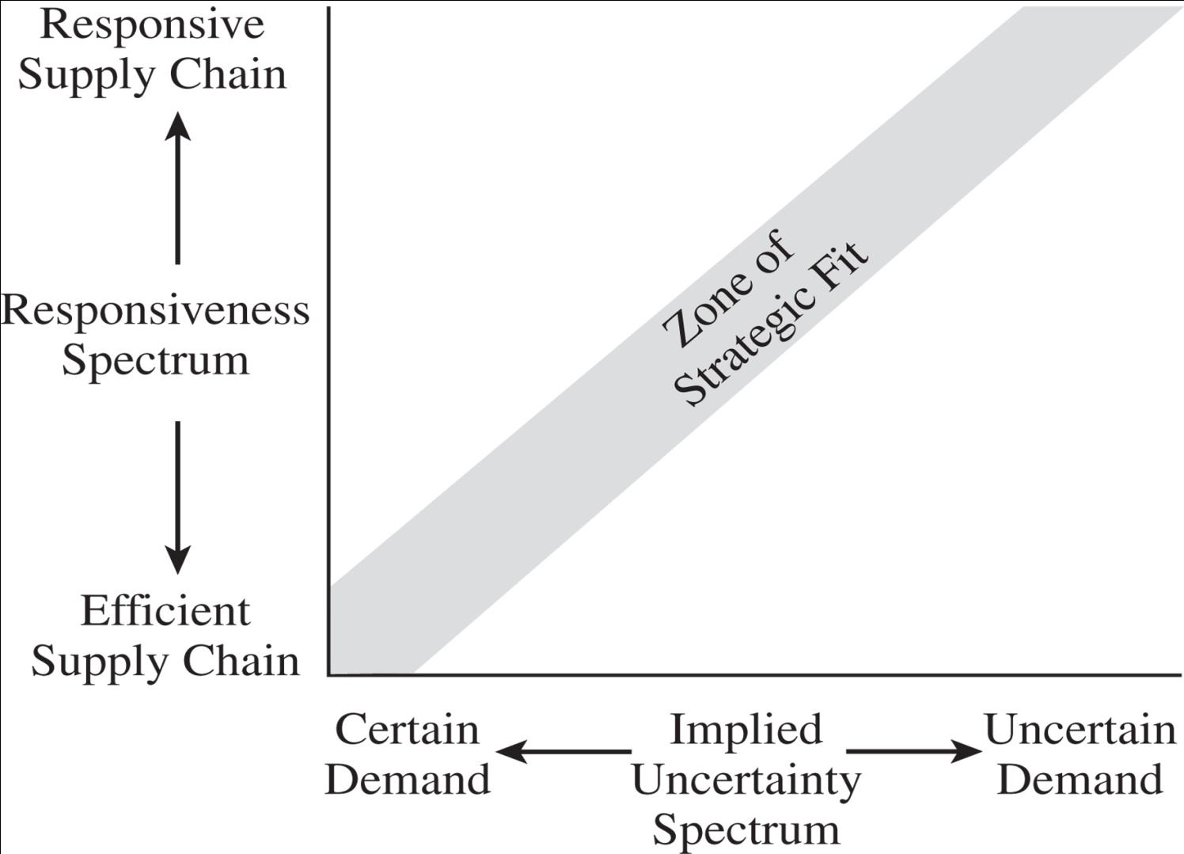
Zone of strategic fit
Figure 2-5

Slide 63
Zone of strategic fit
Example: IKEA- Swedish furniture retailer
It has targeted customers who want stylish furniture at a reasonable cost. Variety is limited. It decreases the implied uncertainty faced by the supply chain. It uses inventory to absorb all the uncertainty faced by the supply chain. IKEA passes along very little uncertainty to its manufacturers, who tend to be located in low-cost countries and focus on efficiency.

Slide 64
Zone of strategic fit
Example: England, Inc. - a furniture manufacturer
Company makes large quantity and deliver it to store within 3 weeks. Retailers do not carry much inventory and implied uncertainty is passed to manufacturer only. By holding more raw material inventories, the company allows its suppliers to focus on efficiency. If it decreases its raw material inventories, its suppliers must become more responsive.

Slide 65
Role and allocation
The supply chain can achieve a given level of responsiveness by adjusting the roles of each stage of the supply chain
Making one stage more responsive allows other stages to focus on becoming more efficient
The best combination of roles depends on the efficiency and flexibility available at each stage

Slide 66
Role and allocation
The notion of achieving a given level of responsiveness by assigning different roles and level of uncertainty to different stages of the supply chain is illustrated in Figure 2-6.

Slide 67
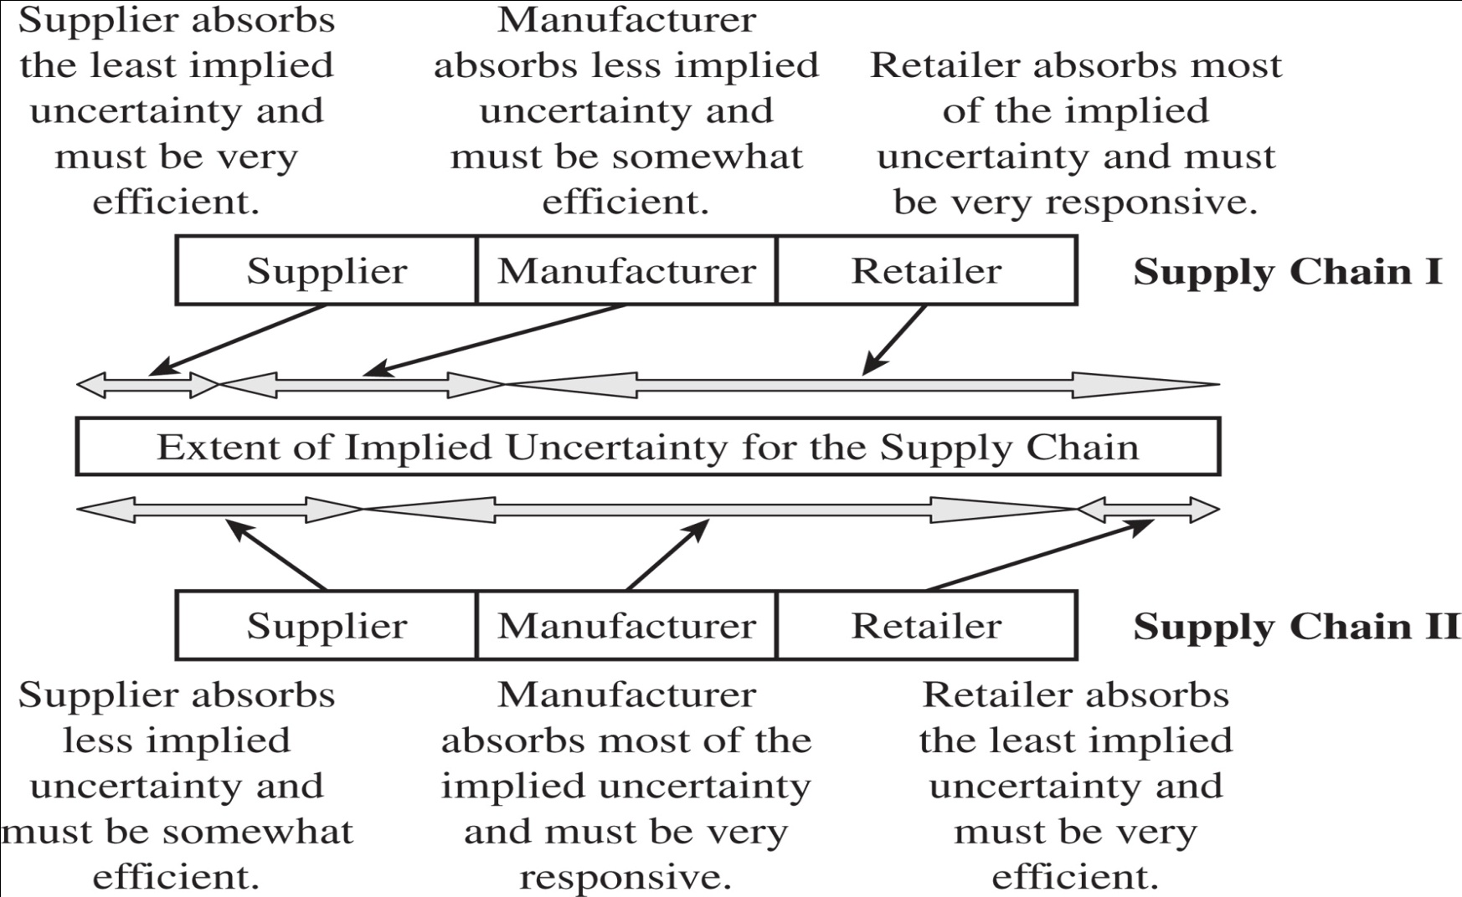
Role and allocation
Figure 2-6

Slide 68
Role and allocation
The figure shows two supply chains that face the same implied uncertainty but achieve the desired level of responsiveness with different allocations of uncertainty and responsiveness across the supply chain

Slide 69
Role and allocation
Supply Chain I has a very responsive retailer who absorbs most of the uncertainty, allowing (actually requiring) the manufacturer and supplier to be efficient.
Supply Chain II, in contrast, has a very responsive manufacturer who absorbs most of the uncertainty, thus allowing the other stages to focus on efficiency.

Slide 70
Fit between competitive and functional strategy
To achieve complete strategic fit, a firm must also ensure that all its functions maintain consistent strategies that support the competitive strategy, as shown in Figure 2-7.
All functional strategies must support the goals of the competitive strategy.
All sub strategies like manufacturing, inventory, and purchasing-must also be consistent with the supply chain's level of responsiveness

Slide 71
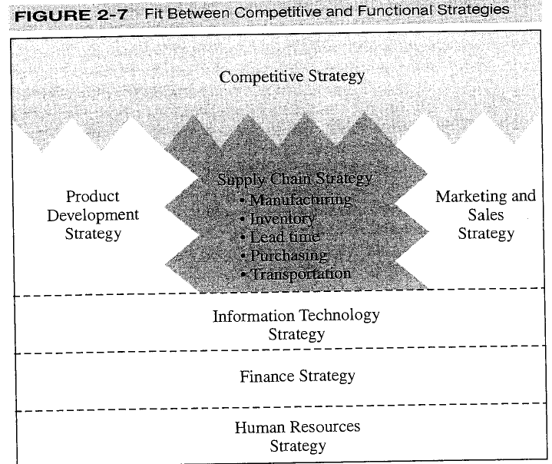

Slide 72
Efficient and Responsive Supply Chains
Firms with different locations along the responsiveness spectrum must have different supply chain designs and different functional strategies that support their responsiveness
Table 2-4 lists some of the major differences in functional strategy between supply chains that are efficient and those that are responsive

Slide 73
Efficient and Responsive Supply Chains
 | Efficient Supply Chains | Responsive Supply Chains
Primary goal | Supply demand at the lowest cost | Respond quickly to demand
Product design strategy | Maximize performance at a minimum product cost | Create modularity to allow postponement of product differentiation
Pricing strategy | Lower margins because price is a prime customer driver | Higher margins because price is not a prime customer driver
Manufacturing strategy | Lower costs through high utilization | Maintain capacity flexibility to buffer against demand/supply uncertainty
Inventory strategy | Minimize inventory to lower cost | Maintain buffer inventory to deal with demand/supply uncertainty
Lead-time strategy | Reduce, but not at the expense of costs | Reduce aggressively, even if the costs are significant
Supplier strategy | Select based on cost and quality | Select based on speed, flexibility, reliability, and quality
Table 2-4

Slide 74
Important points
1. There is no supply chain strategy that is always
right.
2. There is a right supply chain strategy for a given
competitive strategy.
The drive for strategic fit should come from the highest levels of the organization.

Slide 75
Other issues affecting strategic fit
Multiple Products and Customer Segments
Companies produce and sell multiple products to multiple customer segments, each with different characteristics
A department store may sell seasonal products with high implied demand uncertainty, such as ski jackets, along with products with low implied demand uncertainty, such as black socks.
The demand in each case maps to a different part of the uncertainty spectrum

Slide 76
Multiple Products and Customer Segments
Example:
W.W. Grainger sells MRO products to both large firms, such as Ford and Boeing, and small manufacturers and contractors. A large firm is much more likely to be concerned with price, given the large volumes they generate from W.W. Grainger, whereas a smaller company is apt to go to W.W. Grainger because it is responsive.
The two segments that are served map to different positions along the implied uncertainty spectrum.

Slide 77
Multiple Products and Customer Segments
Example: Levi Strauss- clothe manufacturer
It sells standardized and customized jeans. Demand for standard-sized jeans has a much lower demand uncertainty than demand for customized jeans.

Slide 78
Tailoring the Supply Chain
When devising supply chain strategy, the key issue for a company is to design a supply chain that balances efficiency and responsiveness.
To achieve this balance one route is to set up independent supply chains for each different product or customer segment

Slide 79
Tailoring the Supply Chain
To achieve this balance one route is to set up independent supply chains for each different product or customer segment
This idea fails, however, to take advantage of any economies of scope that often exist among a company's different products.

Slide 80
Tailoring the Supply Chain
A preferable strategy is to tailor the supply chain to best meet the needs of each product's demand

Slide 81
Tailoring the Supply Chain
Tailoring the supply chain requires sharing some links in the supply chain with some products, while having separate operations for other links.
The links are shared to achieve maximum possible efficiency while providing the appropriate level of responsiveness to each segment.

Slide 82
Tailoring the Supply Chain
Example:
All products may be made on the same line in a plant, but products requiring a high level of responsiveness may be shipped using a fast mode of transportation such as FedEx. Those products that do not have high responsiveness needs may be shipped by slower and less expensive means such as truck, rail, or even ship.

Slide 83
Tailoring the Supply Chain
Example(cont...)
Products requiring high responsiveness may be manufactured using a very flexible process, whereas products requiring less responsiveness may be manufactured using a less responsive but more efficient process

Slide 84
Tailoring the Supply Chain
Example(cont...):
Some products may be held at regional warehouses close to the customer whereas others may be held in a centralized warehouse far from the customer.
W.W. Grainger holds fast-moving items in its decentralized locations close to the customer. It holds slow-moving items with higher implied demand uncertainty in a centralized warehouse

Slide 85
Changes Over Product Life Cycle
As products go through their life cycle, the demand characteristics and the needs of the customer segments being served change
High-tech products are particularly prone to these life-cycle swings over a very short time span
A product goes through its life cycle from the introductory phase, when supply is uncertain, all the way to the point at which the product becomes a commodity, the market is saturated, and supply is predictable

Slide 86
Changes Over Product Life Cycle
Beginning stages
1. Demand is very uncertain and supply may be unpredictable.
2. Margins are often high, and time is crucial to gaining sales.
3. Product availability is crucial to capturing the market.
4. Cost is often a secondary consideration.

Slide 87
Changes Over Product Life Cycle
Example: A pharmaceutical company
A drug is introduced, initial demand is uncertain, margins are high , availability is key for success. Responsiveness is the most important characteristic of the supply chain.

Slide 88
Changes Over Product Life Cycle
Example(cont...)
Product becomes a commodity. Drug’s patent expires and generic drug is introduced.
1. Demand has become more certain and supply is predictable.
2. Margins are lower due to an increase in competitive pressure.
3. Price becomes a significant factor in customer choice.

Slide 89
Changes Over Product Life Cycle
As products mature, the corresponding supply chain strategy should move from being responsive to being efficient, as illustrated in Figure 2-8.

Slide 90
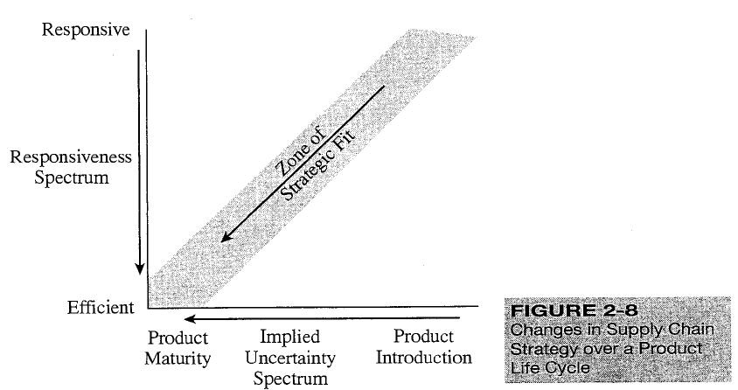
Changes Over Product Life Cycle

Slide 91
Changes Over Product Life Cycle
Example: Intel Corporation
Each time Intel introduces a new computer processor, there is great uncertainty with respect to demand for this new product. Supply is unpredictable because yield is low and variable. At this stage, the Intel supply chain must be very responsive so it can react if demand is very high.

Slide 92
Changes Over Product Life Cycle
Example: : Intel Corporation(cont...)
As the Intel processor becomes more mainstream, demand begins to stabilize, and yield from the production process is higher predictable. At this point demand and supply normally display lower implied uncertainty and price becomes a greater determinant of sales. It is important to have an efficient supply chain

Slide 93
Expanding Strategic Scope
Scope of strategic fit refers to the functions within the firm and stages across the supply chain that devise an integrated strategy with a shared objective
A key issue relating to strategic fit is the scope, in terms of supply chain stages, across which the strategic fit applies

Slide 94
Expanding Strategic Scope
At one extreme, every operation within each functional area devises its own independent strategy with the objective of optimizing its individual performance
At the opposite extreme, all functional areas across all stages of the supply chain devise strategy jointly with a common objective of maximizing supply chain profit

Slide 95
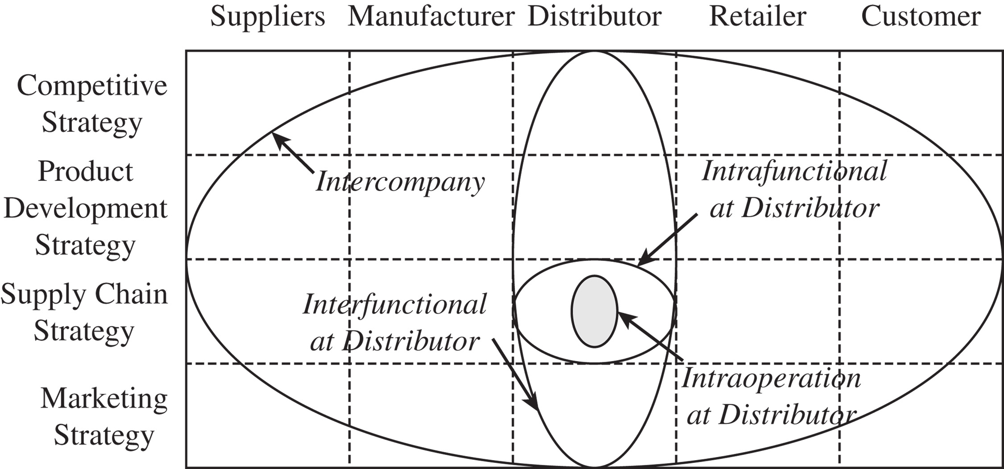
Different Scopes of Strategic Fit Across a Supply Chain
Figure 2-9

Slide 96
INTRACOMPANY INTRAOPERATION SCOPE
Most limited scope over which strategic fit is considered is one operation within a functional area within a company
Each operation within each stage of the supply chain devises strategy independently
Result will most likely not come close to maximizing profit

Slide 97
INTRACOMPANY INTRAOPERATION SCOPE
Example: Distribution company
Transportation operation is evaluated based on
average shipping cost per unit. Shipping the product individually costs $5/item, whereas shipping by truckload costs $1/item. To minimize cost company ships in full truck loads. It reduces responsiveness. This decision is made independent of other functions.

Slide 98
INTRACOMPANY INTRAFUNCTIONAL SCOPE
The strategic fit is expanded to include all operations within a function.
By working together and developing a joint strategy, the total functional cost is minimized.
Figure 2-9 shows the intracompany intrafunctional scope as it applies to the supply chain strategy at the distributor.

Slide 99
INTRACOMPANY INTRAFUNCTIONAL SCOPE
Example: A distribution company
Managers look not only at transportation costs, but also at other supply chain-related costs. Although truckload transportation saves the company $4/item, it costs an additional $8/item because of increased inventory and warehousing costs. So, it costs less to ship each item individually because the extra $4 transportation charge saves the company $8 in inventory related costs.

Slide 100
INTRACOMPANY INTERFUNCTIONAL SCOPE
Different functions may have conflicting objectives. Marketing people focus on revenue generation whereas manufacturing people do cost reduction. Conflicts affect company’s performance.
To maximize company profit all functional strategies are developed to support both each other and the competitive strategy.

Slide 101
INTRACOMPANY INTERFUNCTIONAL SCOPE
Example: A distribution company
Company had decided to ship individual units to bring down inventor costs, marketing wanted to increase inventory so the company could take advantage of increased sales. If the revenues gained outweigh the additional costs, the company should go ahead and increase inventory
Operational and marketing decisions must be correlated.

Slide 102
INTERCOMPANY INTERFUNCTIONAL SCOPE
All stages of supply chain coordinate strategy across all functions, ensuring that together they best meet the customer's needs.
Responsiveness became essential.
The intercompany scope forces every stage of the supply chain to look across the supply chain and evaluate the impact of its actions on other stages as well as on the interfaces

Slide 103
INTERCOMPANY INTERFUNCTIONAL SCOPE
This scope restricts strategic attention within each stage of the supply chain, leading to the interfaces being neglected
This scope allows the supply chain to raise the supply chain surplus and increase the size of the pie that all stages have to share among themselves.

Slide 104
Challenges
Increasing product variety and shrinking life cycles
Greater product variety and shorter life cycles increase
uncertainty while reducing the window of opportunity within
which the supply chain can achieve fit.
Globalization and increasing uncertainty
Significant fluctuations in exchange rates, global demand,
and the price of crude oil.

Slide 105
Challenges
Fragmentation of supply chain ownership
Firms are less vertically integrated
Take advantage of supplier and customer competencies they did not have
New ownership structure makes aligning and managing the supply chain more difficult
Aligning all members of a supply chain has become critical to achieving supply chain fit

Slide 106
Challenges
Changing technology and business environment
Customer needs and technology change may force a firm to rethink their supply chain strategy
The environment and sustainability
Growing in relevance and must be accounted for when designing supply chain strategy
Opportunities may require coordination across different members of the supply chain

Slide 107
Summary of Learning Objectives
Explain why achieving strategic fit is critical to a company’s overall success
Describe how a company achieves strategic fit between its supply chain strategy and its competitive strategy
Discuss the importance of expanding the scope of strategic fit across the supply chain
Describe the major challenges that must be overcome to manage a supply chain successfully

